Slide 1
Equity Risk Assessment
KK Mabebe

Slide 2
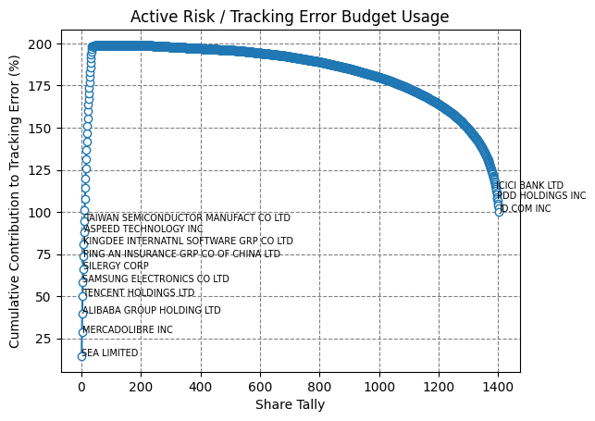
How does portfolio assume it’s Tracking Error

Slide 3
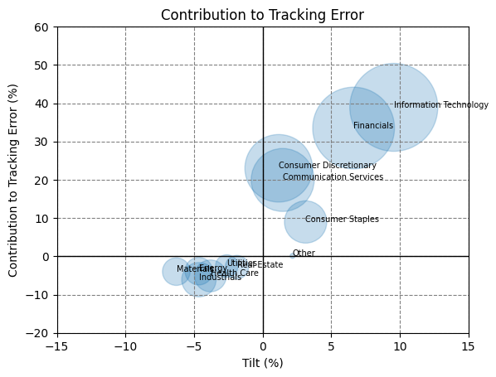
Risk Decomposition – GICS Sectors

Slide 4
Top Risk Contributors

Slide 5
Bottom Risk Diversifiers

Slide 6
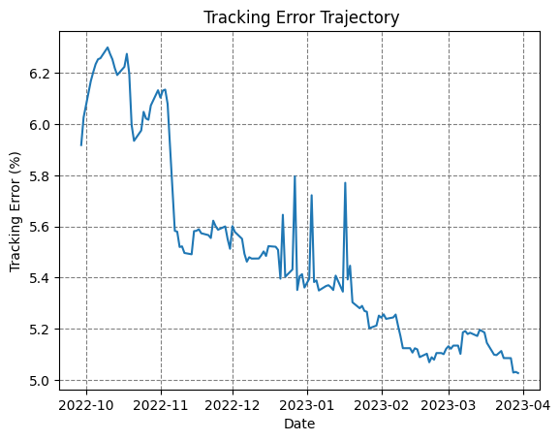
Tracking Error

Slide 7
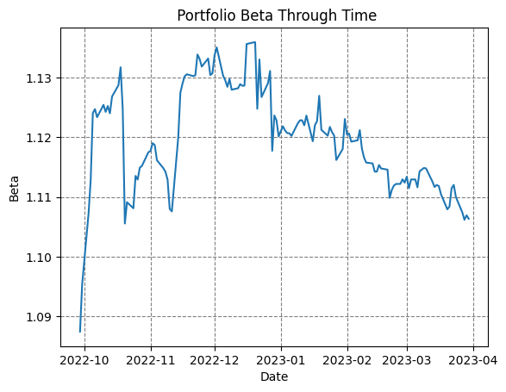
Beta

Slide 8
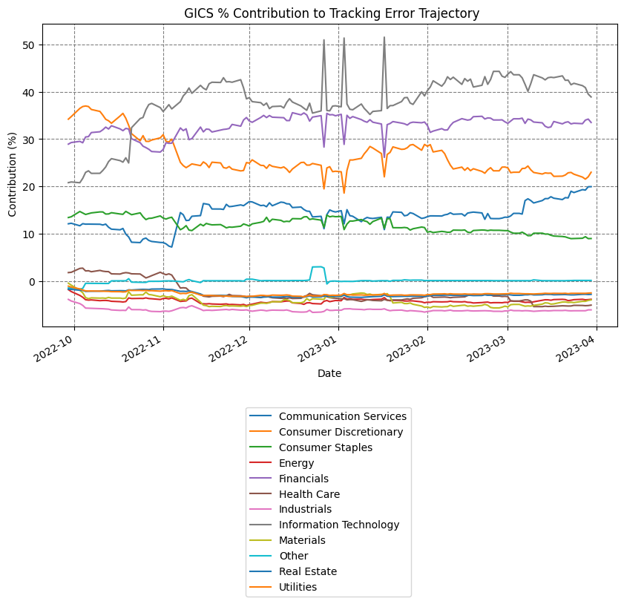
Risk Decomposition – GICS Sectors

Slide 9
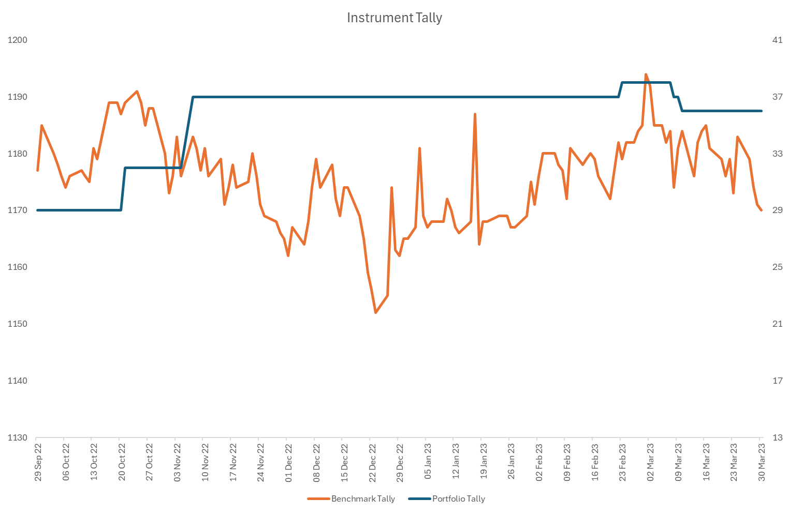
Instruments Tally

